Slide 1

Apache Flink
-ARUNIT GUPTA

Slide 2
Agenda
Introduction
Flink Ecosystem
Architecture
Spark vs Flink
Applications
Features
Concepts
Implementation
References

Slide 3
Apache Flink
Stable Release : 1.1.1 / August 11, 2016
Real Time Processing of Streaming data
Low Latency and high fault tolerance.
Spark uses batch processing, Flink uses Iterations (Streaming Architecture)
Open Source
100X faster than Hadoop
Programming APIs for Java and Scala.
Tested on Clusters.

Slide 4

Flink Ecosystem
Flink runs on Yarn
Works with HDFS
Stream data from Kafka
Execute Hadoop program code
Connects to other data storage system.

Slide 5
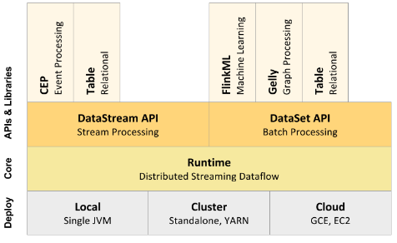
Architecture

Slide 6
Spark vs Flink
 | Spark Streaming | Apache Flink
Guarantee | Exactly Once
Throughput | High
Overhead of Fault Tolerance | Low
Computation Model | Micro Batches | Streaming
Window Criteria | Time Based | Record Based or User Defined
Memory Management | Configured | Automatic

Slide 7
Data Flow
Batch
Micro Batch
Continuous flow operator
Spark
Flink

Slide 8
Applications
Industry | Micro Batch/Real Streaming | Real time streaming
Finance | Credit card fraud detection | Fraud Prevention
AD-Tech | Aggregating SPAM Bot/IP for blacklisting | Spam Preventing
Telecom | Usage aggregation | Network anomaly detection
IOT | Industrial equipment usage trend line. | Alerting when a threshold is reached

Slide 9
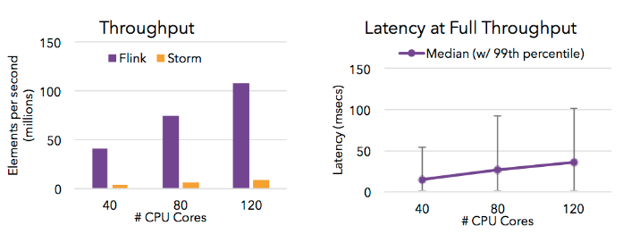
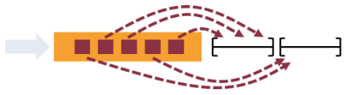
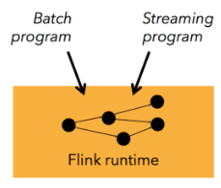
Features
High throughput and low latency.
Support for event time and out of order events
One runtime for Streaming and batch processing

Slide 10
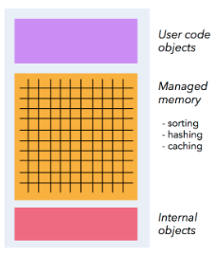
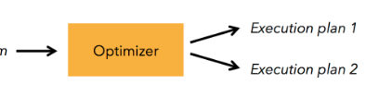
Features
Memory management
Program optimizer

Slide 11
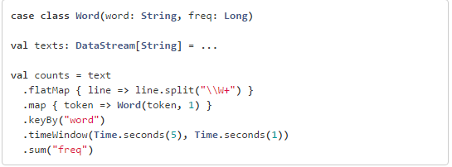
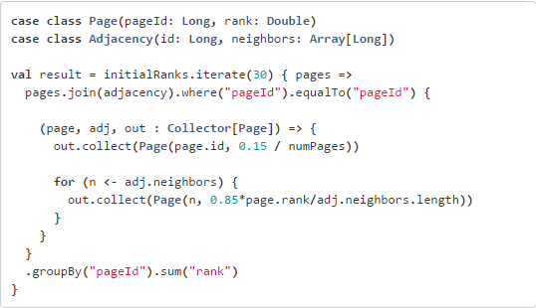
API and Libraries
Streaming Data Applications
Batch Processing Applications

Slide 12
Program and Dataflow
Basic Building blocks of Flink: Streams and Transformation.
Stream: Intermediate result; Transformation: operation which take one or more stream as input.
On execution, Flink programs are mapped to streaming data flows, consisting of streams and transformation operators. Each dataflow starts with one or more sources and ends in one or more sinks. The dataflow may resemble arbitrary directed acyclic graphs (DAGs).

Slide 13
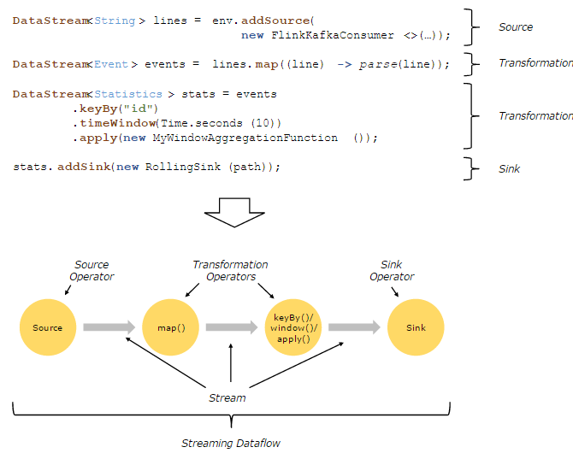
Program and Dataflow

Slide 14
Parallel Dataflow
Programs in Flink are inherently parallel and distributed. Streams are split into stream partitions and operators are split into operator subtasks.
The operator subtasks execute independently from each other, in different threads and on different machines or containers.
The number of operator subtasks is the parallelism of that particular operator. The parallelism of a stream is always that of its producing operator. Different operators of the program may have a different parallelism.

Slide 15
Parallel Dataflow

Slide 16
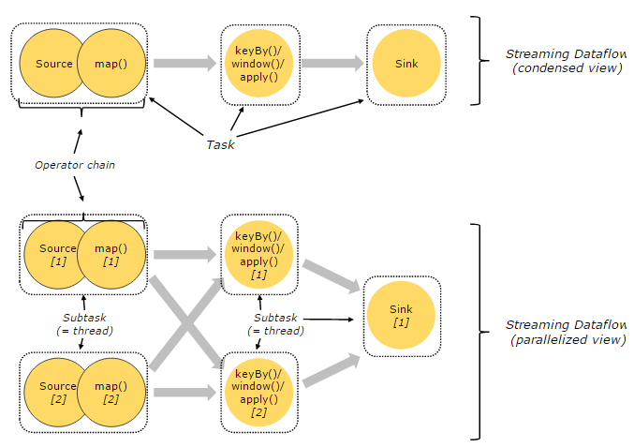
Tasks and Operator chains
Flink chain operator subtasks together into tasks.

Slide 17
Distributed Execution
Master, Worker, Client
The Flink runtime consists of two types of processes:
Master processes: Also called Job Managers who coordinate the distributed execution. They schedule tasks, coordinate checkpoints, coordinate recovery on failures, etc.
At least one master process. A high-availability setup will have multiple master processes, out of which one is always the leader, and the others are standby.
Worker processes: Also called Task Managers execute the tasks or subtasks of a dataflow, and buffer and exchange the data streams.
The client is not part of the runtime and program execution, Client runs as a part of Java/Scala program that triggers the execution or in command line process.

Slide 18
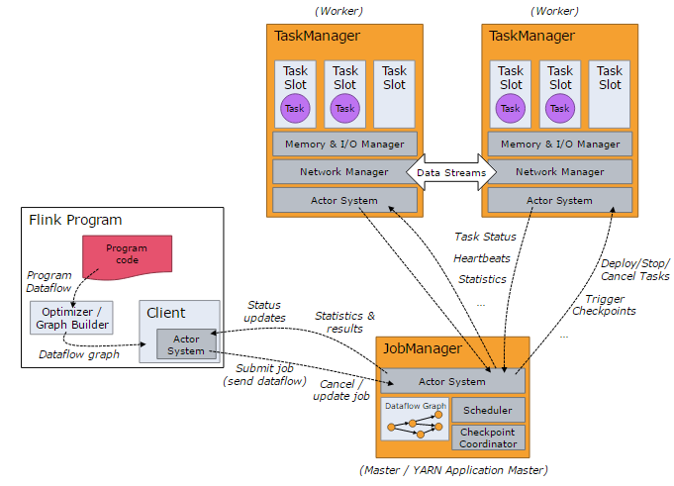
Distributed Execution

Slide 19
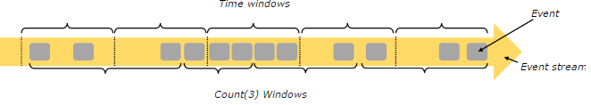
Time and Windows
Aggregating events works slightly differently on streams than in batch processing. For example, it is impossible to first count all elements in the stream and then return the count, because streams are in general infinite. Instead, aggregates on streams, are scoped by windows, such as “count over the last 5 minutes”, or “sum of the last 100 elements”.
Windows can be time driven (example: every 30 seconds) or data driven (example: every 100 elements).

Slide 20
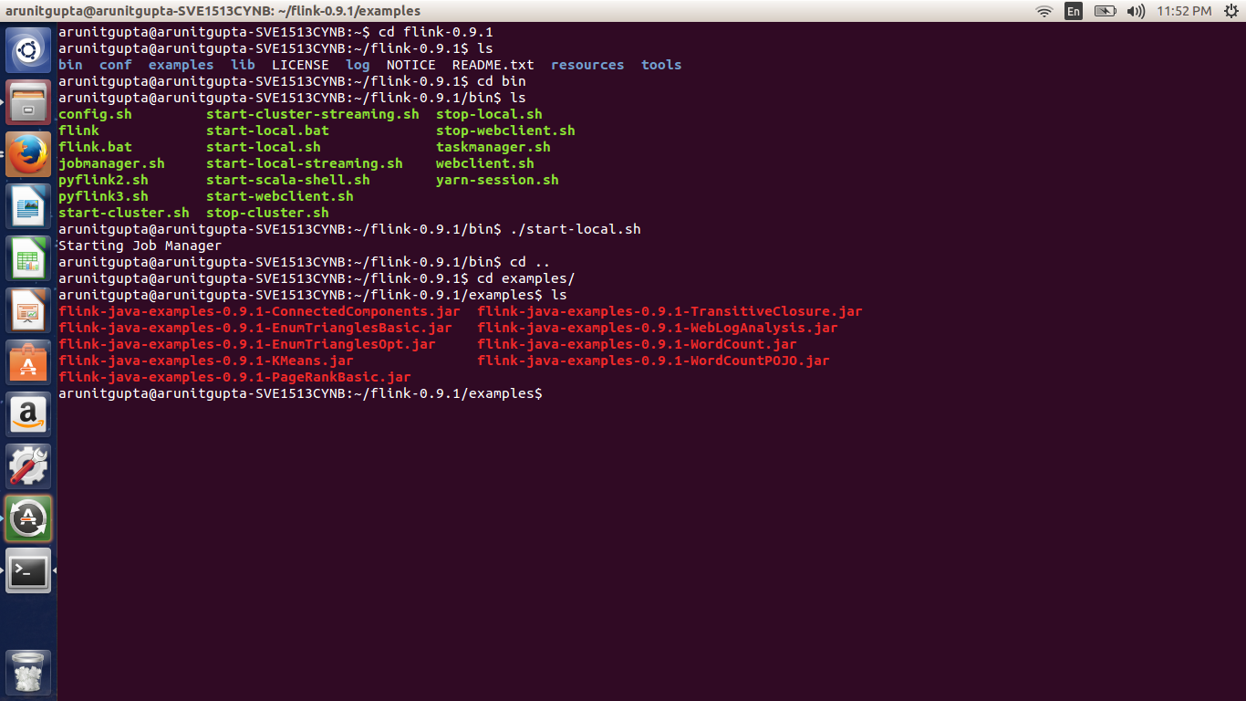
Running Flink

Slide 21
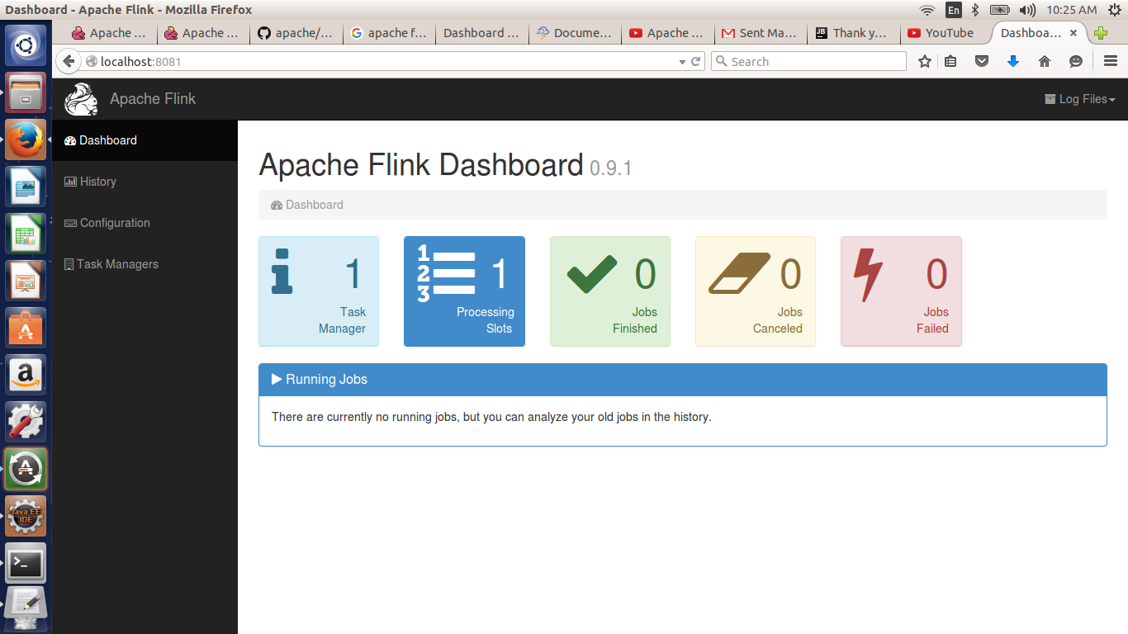
Flink Console

Slide 22
References
https://ci.apache.org/projects/flink/flink-docs-master/
https://www.youtube.com/watch?v=BtL_WxAo1W8
https://www.youtube.com/watch?v=Dzx-iE6RN4w

Slide 23


